Slide 1
Lecture 4
Outline
4.0 Memory Organization and Management
4.1 Real Memory
4.2 Memory Management Technique
4.2.1 Single User dedicated systems
4.2.2 Fixed Partition
4.2.2.1 Absolute
4.2.2.2 Relocatable
4.2.3 Variable Partition
4.3 Visual memory
4.3.1 Paged
4.3.2 Segmented
4.3.3 Segmented paged

Slide 2
MEMORY MANAGEMENT
The organization and management of the computer’s main storage has greatly affected the evolution of the design of Operating Systems.
The objectives of memory management are to obtain:
A high efficiency of resource utilisation.
A satisfactory performance in the overall aims of the computer utilisation.
- The technique to use depends on the particular characteristics of the hardware available and the nature of the workload.

Slide 3
Memory Management Techniques
Single User (Single Contiguous) Memory Allocation
Unused space
Limit Register
User Area
User’s Address Space
Base Register
Operating System
Operating System Area

Slide 4
There are two techniques for achieving memory protection:
1. Base-Limit Register
-Two registers are used such as
. Base Register which points to the lowest point of the User’s Address Space and
. Limit Register which points to the highest point of the User’s Address Space.
. If the contents of Base register < Effective Address < contents of Limit register, memory is not violated. Otherwise there is memory violation or unauthorized access.
2. Protection Key
-Each User’s address space is given a different protection key with respect of that of the operating system.
-Each address generated will cause a comparison of the protection keys.
-If there is no disparity that will indicate memory violation otherwise we have authourised access.

Slide 5
The major merits of the technique
1. Lies in its simplicity.
2. It helps to achieve automatic job sequence.
The major demerits are:
1. Poor utilisation of memory.
2. Poor utilisation of processors.
This is because no attempt is made at resource sharing through multiprogramming.
3. Users are limited to the size of the user area.

Slide 6
Fixed Partition Memory Allocation
OS
Partition are created which hold different jobs. The size of a partition is fixed.
There is the need for memory protection so that jobs don’t interfere with one other.
User
Area
This is one of the simplest memory management techniques for supporting multiprogramming.
Memory protection is required and it can either be:
The base-limit register technique or 2) The protection-key technique
In addition a table referred to as JOB ALLOCATION TABLE is maintained. This table indicates which partition is in use or which partition is not in use.

Slide 7
Partition No. | Size | Status
1
2
3
:
:
N
Job Allocation Table
Advantages
It permits resource sharing
Each partition may be used to run a whole batch of jobs.
It gives an improves turnaround time.
Disadvantages
There is an increase in complexity both in the allocation and reclaim of the resource.
The user is confined to only part of the available user area within fixed partition.
The technique is not flexible.

Slide 8
For Fixed Partition Memory Allocation, two methods of implementation can be used;
Absolute Fixed Partition – The user’s jobs are compiled as absolute programs and job queues are therefore created for each partition, i.e. the programs can only run in only one of the partition.
ii) Relocatable Fixed Partition – The user’s jobs are compiled as relocatable program and therefore can run in any available partition that is large enough to accommodate them. As a result there is only one job queue.

Slide 9
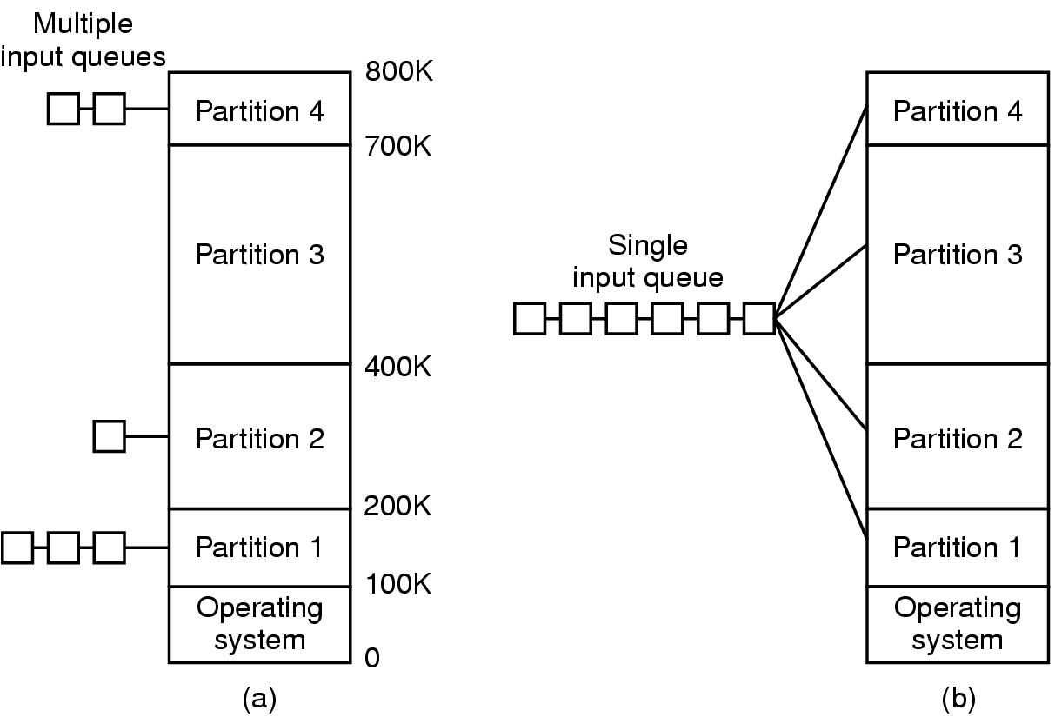
Multiprogramming with Fixed Partitions
Fixed memory partitions
  separate input queues for each partition (Absolute)
  single input queue (Relocatable)

Slide 10
Variable Partition Memory Allocation
The variable partition memory management technique involves the creation of partition during job processing.
This is to match partition sizes to job sizes. This essentially solves the problem of inflexibility of fixed partition management.
256k
JOB3
JOB2
JOB1
OS
Job Queue
Job No. Job Size Run Time
1 60k 10
2 100k 5
3 30k 20
4 70k 8
5 50k 15
230k
200k
100k
40k
0
Assume that the queue is serviced on ‘’First-Come, First-Serve’’ basis and ‘’Round-Robin CPU Scheduling’’ is used.

Slide 11
Each job uses the CPU for some time, then the CPU is switched onto the next job.
In the example, Job 2 will run to completion. Loading the next job 4 creates another unused space resulting in Core Fragmentation.
Job 1 will then run to completion and Job 5 can be loaded since available space is greater than what job 5 required. The jobs will then run to completion but leaving 26k + 30k + 10k unused spaces.

Slide 12
Various tables are maintained, the entries being the allocated and unallocated
-Allocated Partition Status Table (APST)
-Unallocated Area Status Table (UAST)
Partition # | size | Start Location | status
1 | 50k | 40 | Allocated
2 | 70k | 100 | ,,
3 | 30k | 200 | ,,
256
JOB3
JOB4
JOB5
OS
230
200
170
100
90
40
Partition # | size | Start Location | status
1 | 10k | 90 | Unallocated
2 | 30k | 170 | ,,
3 | 26k | 230 | ,,
0
If any job is selected to be run, a new partition will be created from the unallocated area and the tables updated.

Slide 13
Methods of Allocation – Selecting Appropriate Free Area
There are two methods for the allocation of free areas:
-First Fit and -Best Fit Methods
First Fit
-The unallocated status table is kept sorted by starting location. That is each consecutive entry corresponds to a free area that starts at a higher memory address.
-To allocate we scan this table at the lowest address to find the first free area big enough for the job.
Merits
-It favours using free areas at low memory address. This tends to allow large free areas to be formed at high memory addresses.
-For reclaim of the memory one does not need to search the whole of the free (unallocated) table.

Slide 14
-The only demerit is that one has to reorganise the table any time a free area is created.
Best Fit
-The unallocated area status table is maintained sorted by the size of the free area. That is, the first entry corresponds to the free area with the smallest size.
-To allocate memory to a job we scan the table for the first free area closest in size but larger than or equal to the desired job size.
Merits
-On the average only half the table need to be searched in order to find the best fit free area.
-If there is a free area of exactly the desired size it will be selected but this is not necessarily so in the case of the first fit.

Slide 15
-If there is no free area of exactly the desired size, the partition can be created out of the smallest possible free area with the result that large free areas will not be destroyed.
Demerit
-The disadvantage is that as the required area is carved out of the smallest free area it leaves several small free areas which are usually worthless.

Slide 16
Pros and Cons of Variable Partition Memory Allocation Technique
Merits
-There is increase flexibility in core utilisation.
-Since there are several jobs in core, there is a high degree of resource sharing.
-Large programs may be allocated the whole of the user area since the number of partitions is not fixed.
Demerits
-It has a more complex algorithm for the allocation and reclaiming of the resource.
-There may be core fragmentation i.e. a large number of separated free areas.
-The job’s partition size is limited to the size of the user area.

Slide 17
Core Fragmentation
Core Fragmentation
Internal Fragmentation
External Fragmentation
P₃
External Fragmentation – Situation where a partition size can’t be allocated to any job because it is too small
P₂
JOBa
Internal Fragmentation – arises from the situation where a job size is less than a partition size.
P₁
JOBb
OS
Note: In variable partition one cannot have internal fragmentation but external fragmentation. In a fixed partition one can have both internal and external fragmentation

Slide 18
Solving the problem of Core Fragmentation
This may be effected by using two methods:
Coalescing 2. Core Compaction (Garbage Collection)
Coalescing
This process merged adjacent free areas into a single large free area. It is only possible if the free areas are adjacent to one another.
Core Compaction
This involves moving all occupied areas of storage to one end of the memory.
It leaves a single large free area at the other end of the memory.
Drawbacks of Core Compaction
1. It consumes system resource that could otherwise be used productively.
2. The system must stop everything while it performs the compaction. This often gives wrong response time for interactive users.

Slide 19
3. Compaction involves relocating the jobs that are in memory.This means that the relocation information that is lost when a program is loaded into memory must now be kept in a readily accessible form.

Slide 20
Reloctable Partition Memory Allocation
This technique is an attempt to solve core fragmentation.
The technique works by keeping a base register also referred to as a relocation register into which is loaded the load point of an address space.
Using this, the effective address of an instruction is evaluated just before the execution of that instruction.
The base register or the relocation register is accessible only to the operating system.
In this technique core compaction may either be carried out immediately after a partition is vacated or it may be carried out whenever a free space is not available for an incoming job.

Slide 21
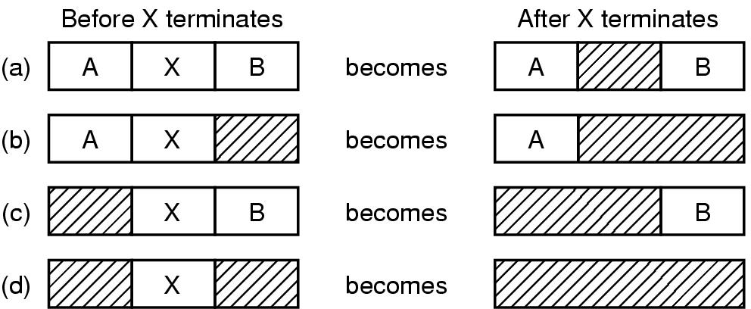
Memory Management with Linked Lists
Four neighbor combinations for the terminating process X

Slide 22
Merits
The technique eliminates core fragmentation
It increase memory and processor utilisation.
Demerits
-The relocation hardware increases the cost of the computer system.
-The time used for core compaction may be long.
-The partition for a job is limited by the size of the user area.

Slide 23
Paged Memory Allocation
n
n-1
n-2
:
5
4
3
2
1
OS
User Area is divided into equal sections called BLOCKS or PAGE FRAMES.
5
4
3
2
1
User’s Address space is divided into equal sections called PAGES
Pages are loaded into any available block not necessarily sequential.

Slide 24
. In this scheme each user’s address space is divided up into equal regions called PAGES. The memory is also divided up into regions of the same size called BLOCKS or PAGE FRAMES.
.The choice of page size affects the usefulness of the technique.
-If it is too large the scheme becomes comparable to the relocatable partition technique.
-If the size is too small, the system cost becomes very high.
-The page size used in most paging systems is from 1k to 4k bytes.
-The hardware required to support the scheme are three tables.

Slide 25
In order to keep track of the resource, we have three types of tables, namely
-Job table
-Page map table
-Memory block table
Job Table
Page Map Table
Memory Block Table
Job ID | Location of Page Map Table
Page # | Block #
1 2 3 4 5 6 7 | 4 7 2
Block # | Status
1 | Free/Used
2
:
N

Slide 26
-The pages of an address space are loaded into blocks of memory and the page map table is built up. The memory block table is also updated.
-When a job runs to completion the blocks used by it are returned to the free status by updating the entries in the Memory Block Table.
-In this scheme every instruction, apart from the Operation Code, is divided into two parts called the Page Number and the Displacement within the page.
OP | Page # | Disp.
Address
Merits
-The technique eliminates core fragmentation.
-It allows high degree of multiprogramming.
-The core compation overhead as found in relocatable partition memory allocation scheme is eliminated.

Slide 27
Demerits
-The page address mapping hardware increases the cost of the computer system.
-Memory is used in storing the tables needed to manage the technique and processor time is also used to maintain these tables.
-Internal fragmentation may occur.
-the jobs address space is limited to the size of the user area.

